Slide 1

Github Repositories Trend analysis
By
1.Prapullanath Divi
2.Chaitanya Chowdary
3.Harsha Arepalli
4.Sunnt Rohit Gattu

Slide 2
Abstract
This project analyzes a dataset containing daily updates on trending GitHub repositories, focusing on key metrics such as stars, forks, and repository descriptions. The aim is to identify trends in popular projects across various programming languages, providing insights into developer preferences and emerging technologies. Through data processing, cleaning, and visualization, we uncover patterns that can inform future development efforts and community engagement.

Slide 3
Introduction
GitHub has become a central hub for developers, hosting millions of repositories that showcase a wide array of projects. Understanding which repositories trend can provide valuable insights into the technologies and practices that are gaining traction in the developer community. This project leverages a dataset of trending repositories to explore the dynamics of popularity, the evolution of programming languages, and the factors that contribute to a repository's success.

Slide 4
Objectives
To analyze the trends in GitHub repositories based on daily updates.
To identify the most popular programming languages and technologies.
To explore the relationship between repository features (stars, forks, etc.) and their popularity.
To visualize trends over time and provide actionable insights for developers and organizations.

Slide 5

Dataset Overview
The dataset consists of daily snapshots of trending GitHub repositories, including:
Repository Name: The name of the repository.
Stars: The number of stars received.
Forks: The number of forks.
Description: A brief description of the repository.
Programming Language: The primary language used in the repository.
Date: The date of the snapshot. This dataset allows for longitudinal analysis of trends and patterns in repository popularity.

Slide 6
Data Processing
Data processing involved several steps to prepare the dataset for analysis:
Loading the Data: Importing the dataset into a suitable environment (e.g., Pandas in Python).
Exploratory Data Analysis (EDA): Conducting initial analyses to understand the structure and distribution of the data.

Slide 7
Cleaning Missing Values
Missing values were identified and handled using the following strategies:
Removal: Rows with critical missing values (e.g., repository name) were removed.
Imputation: For non-critical fields, such as descriptions, missing values were filled with a placeholder (e.g., "No description available").

Slide 8
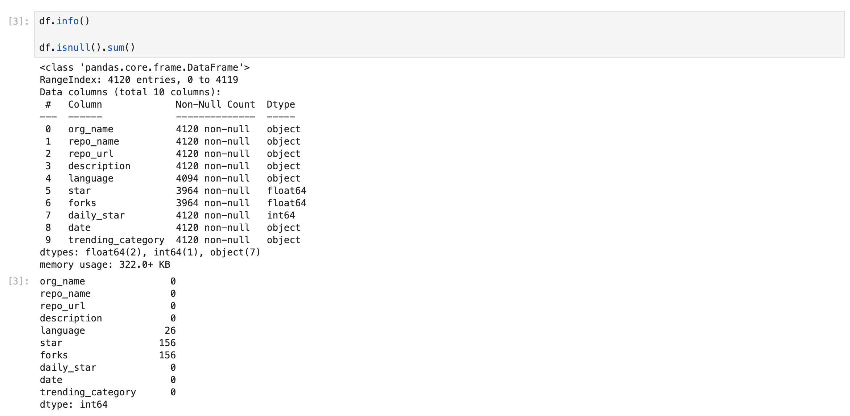
This is the steps we used to clean the missing values

Slide 9

Format Adjusting
Data formats were adjusted to ensure consistency:
Date Formatting: Dates were converted to a standard format (e.g., YYYY-MM-DD).

Slide 10
Feature Adjusting
Feature engineering was performed to enhance the dataset:
Popularity Score: A new feature was created to combine stars and forks into a single metric.
Language Encoding: Programming languages were encoded into categorical variables for analysis.

Slide 11
Literature Review
The literature review examined previous studies on GitHub trends, focusing on:
The impact of community engagement on repository success.
The role of programming languages in developer preferences.
Trends in open-source contributions and their implications for the tech industry.

Slide 12
Methodology
The methodology included:
Descriptive Analysis: Summarizing key statistics of the dataset.
Trend Analysis: Identifying trends over time using time-series analysis.
Correlation Analysis: Examining relationships between features (e.g., stars vs. forks).
Visualization: Creating graphs and charts to illustrate findings.

Slide 13
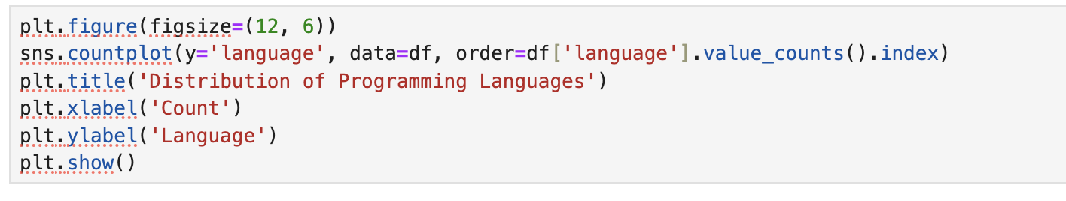
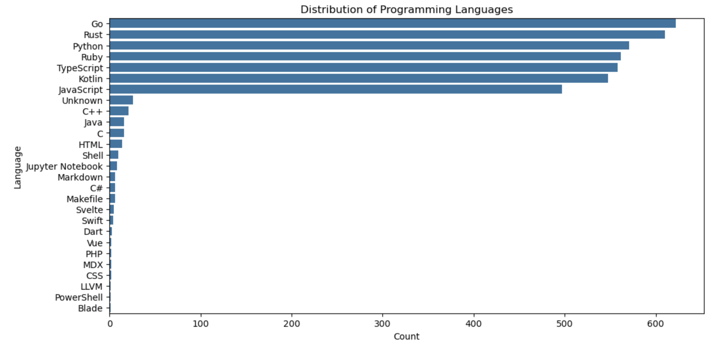
Distribution of programming Languages
This chart shows the details of the programming languages which are used by the trending repos in Github
In this chart we see that the languages such as Go, Rust and Python are currently trending
Github is an industry standard for
Programmers which gives the current insights of the market

Slide 14
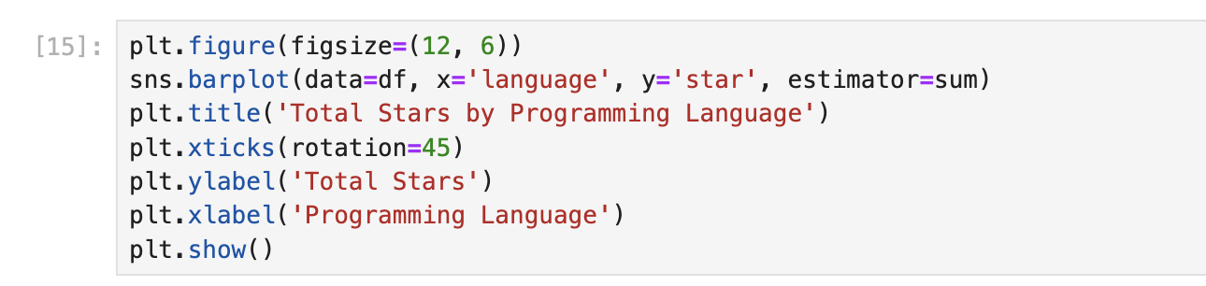
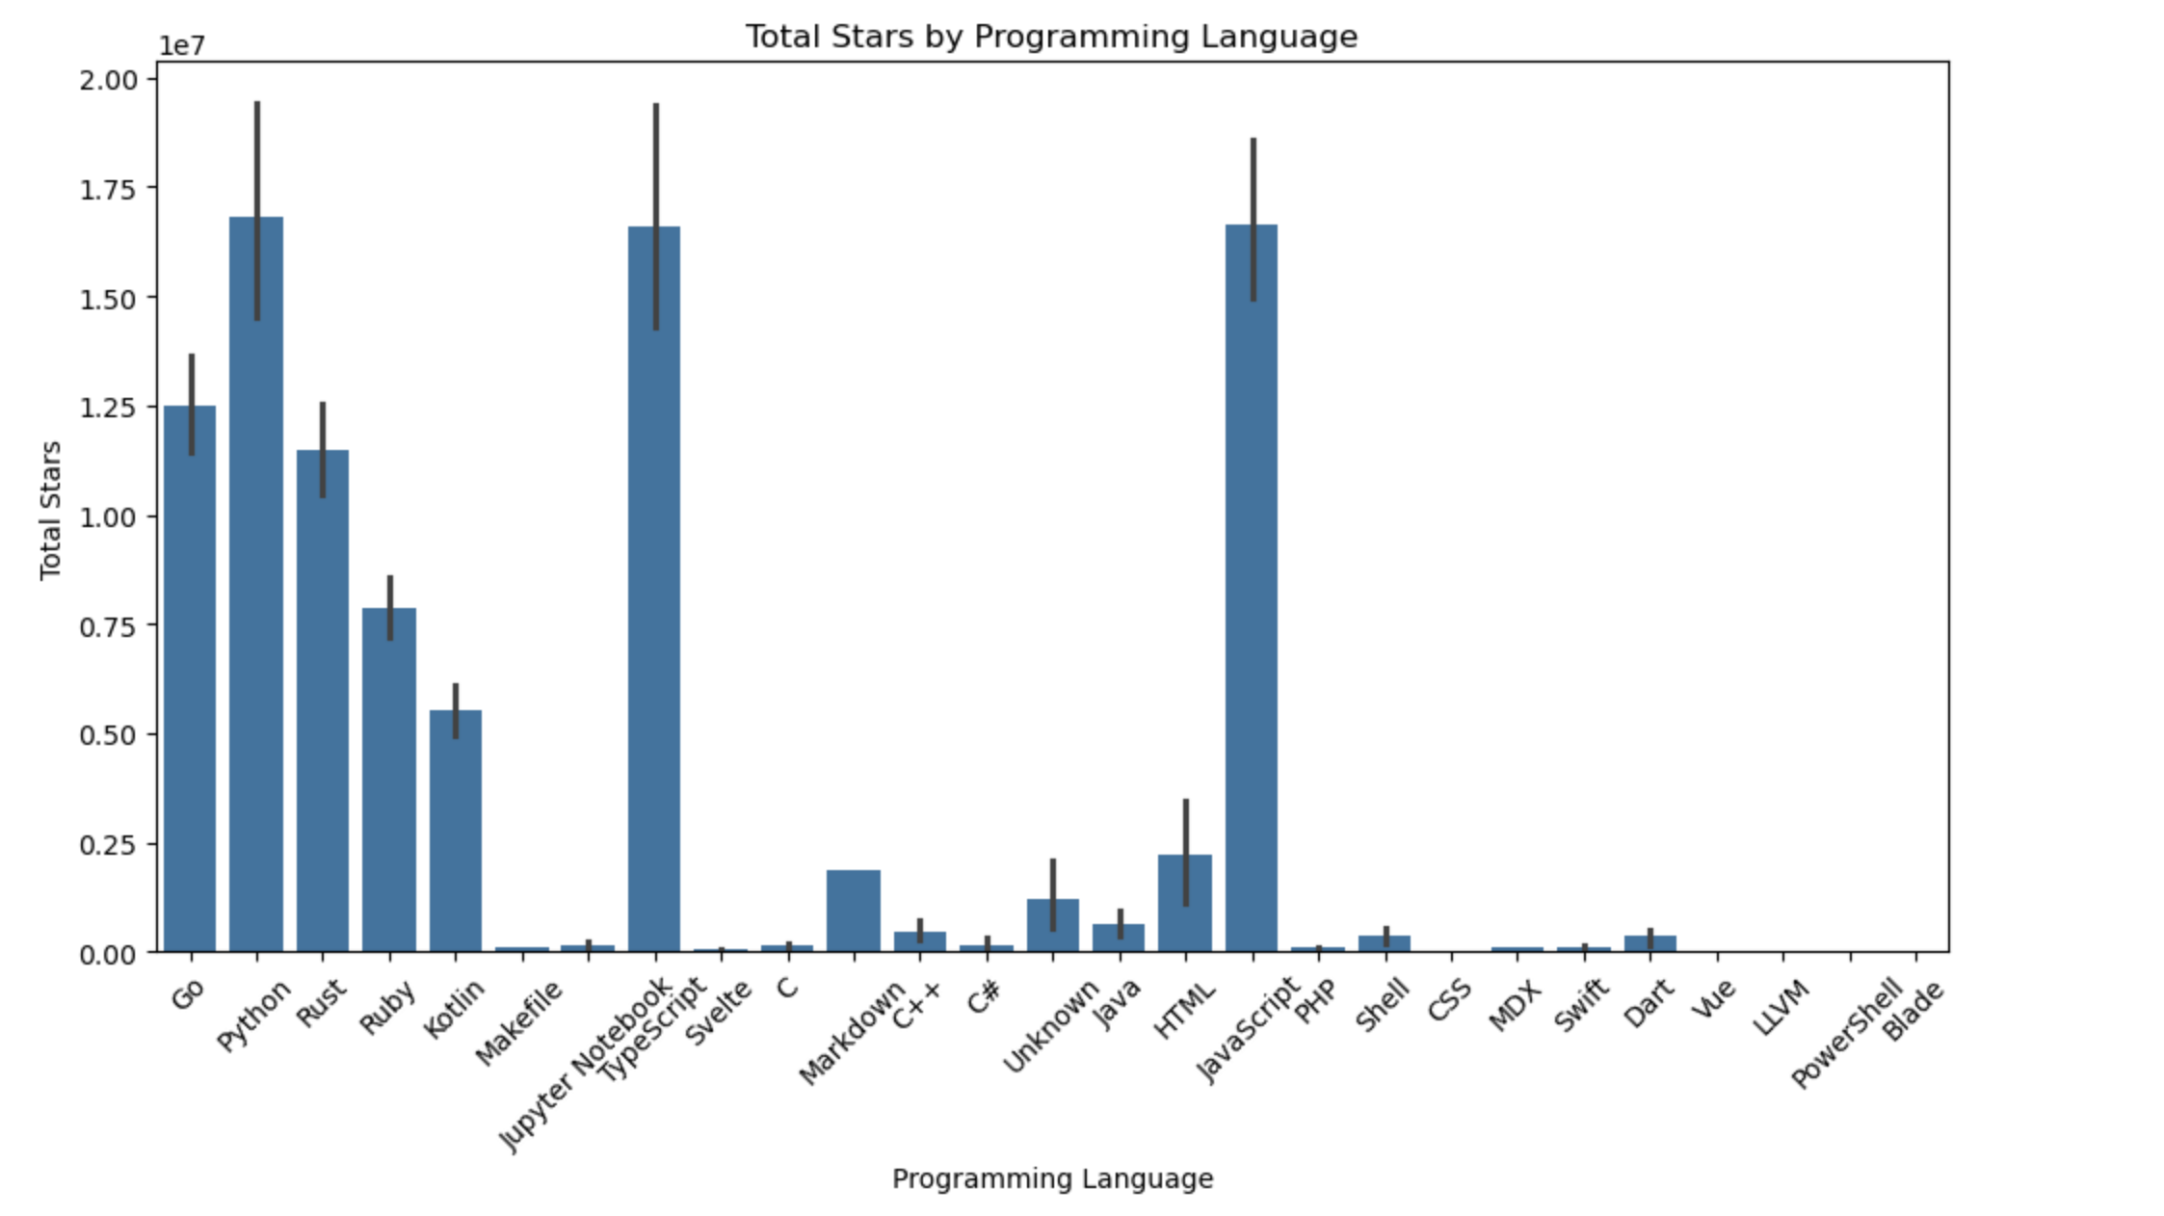
Total starts given by programmers for languages
This Bar chart shows
JavaScript has the most stars, followed by Python and Go.
TypeScript, C++ and Java are all in the top ten.
C and C# have a lower number of stars compared to other popular languages.
Shell and HTML are on par with C and C# in terms of star count.
The remaining languages have significantly fewer stars than the top 10.

Slide 15
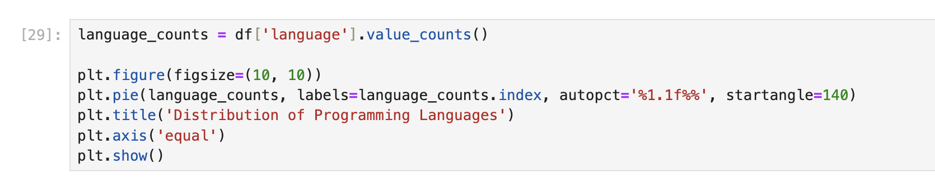
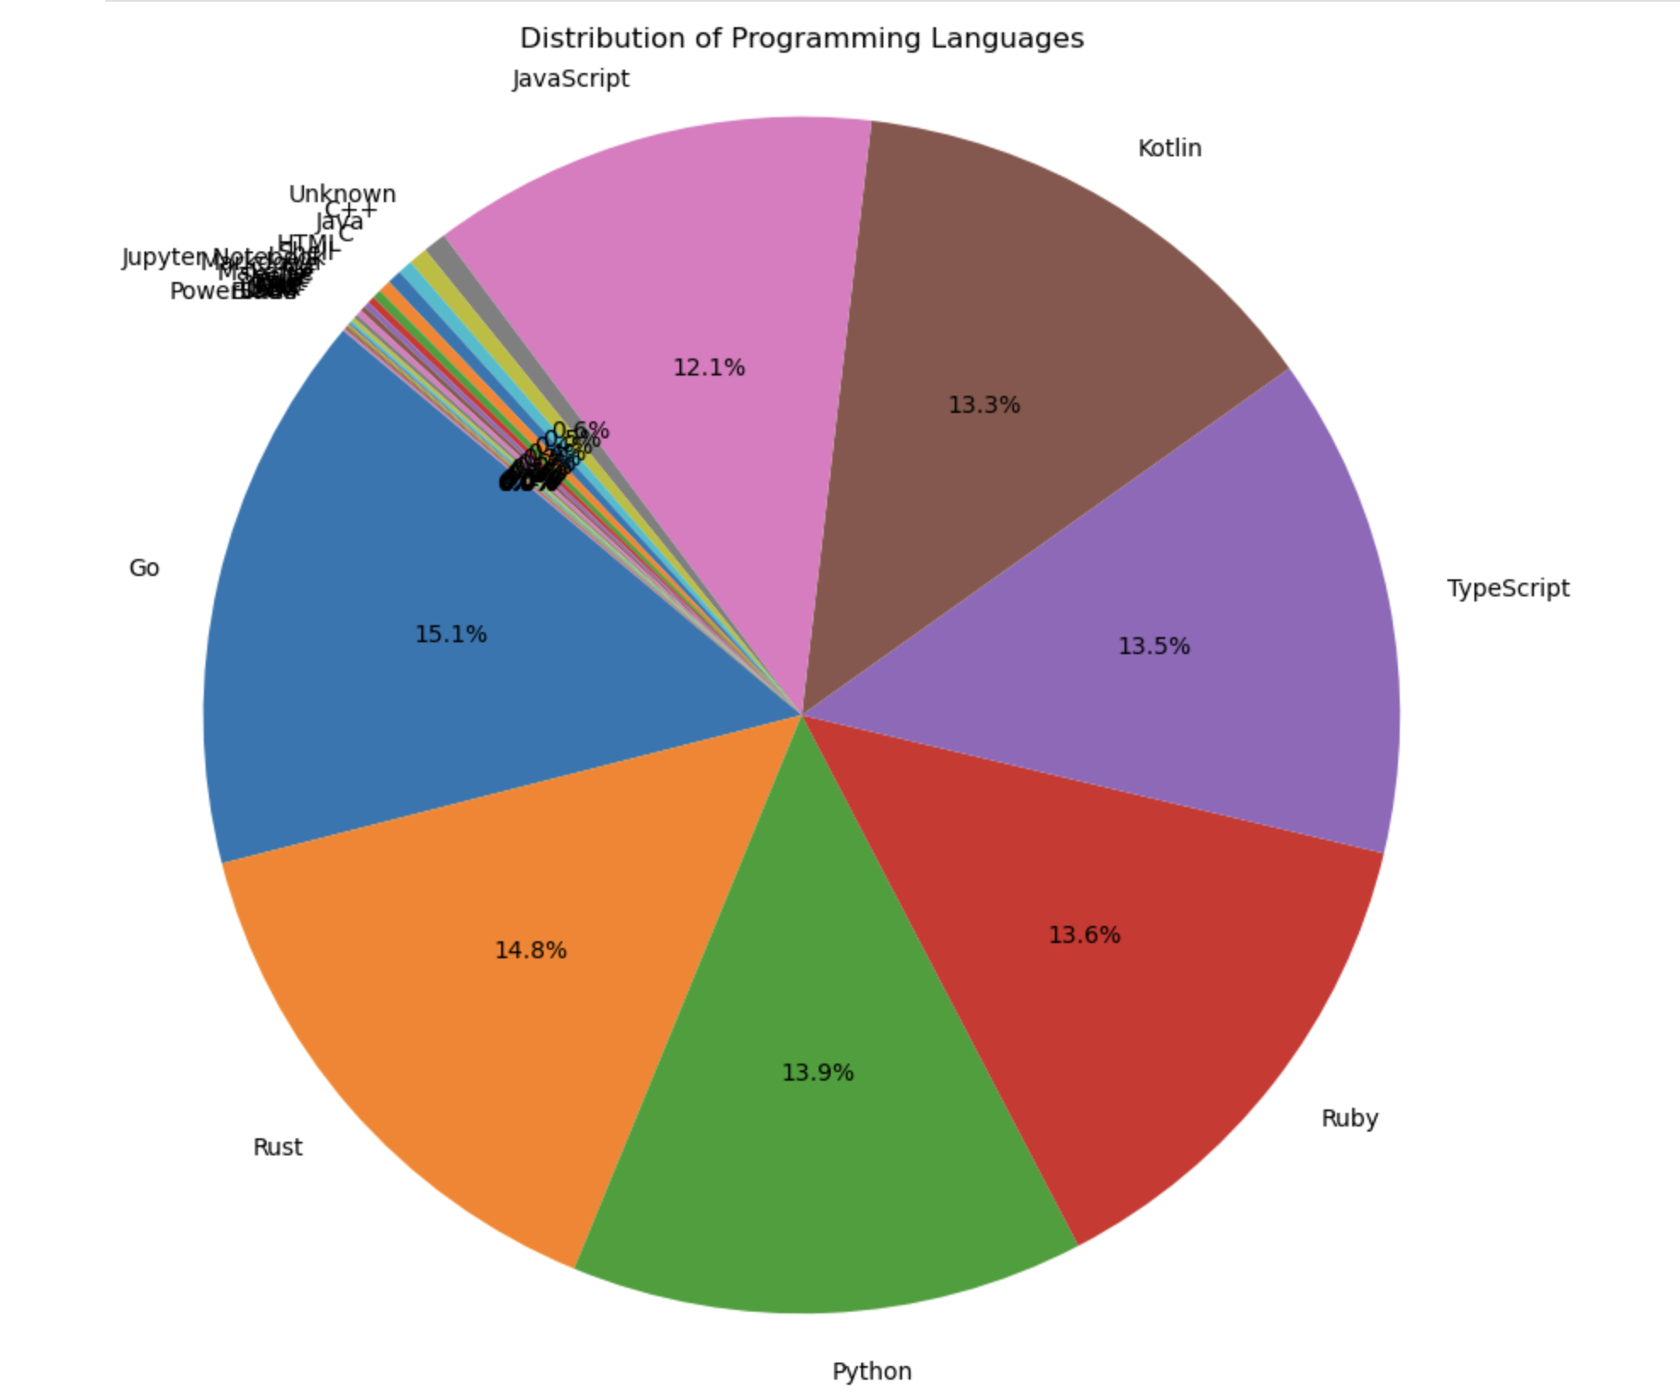
Distribution of Programming languages:
This is a pie chart that shows the distribution of different programming languages:
JavaScript: 12.1%
Kotlin: 13.3%
TypeScript: 13.5%
Ruby: 13.6%
Python: 13.9%
Rust: 14.8%
Go: 15.1%
The remaining languages are listed as "unknown" and make up a very small percentage of the pie chart.

Slide 16
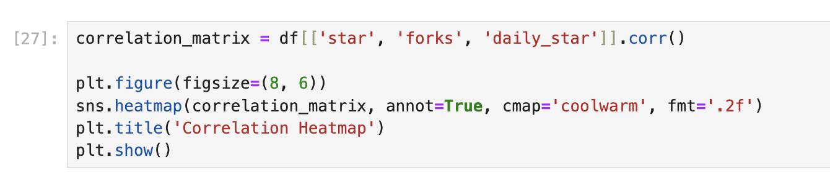
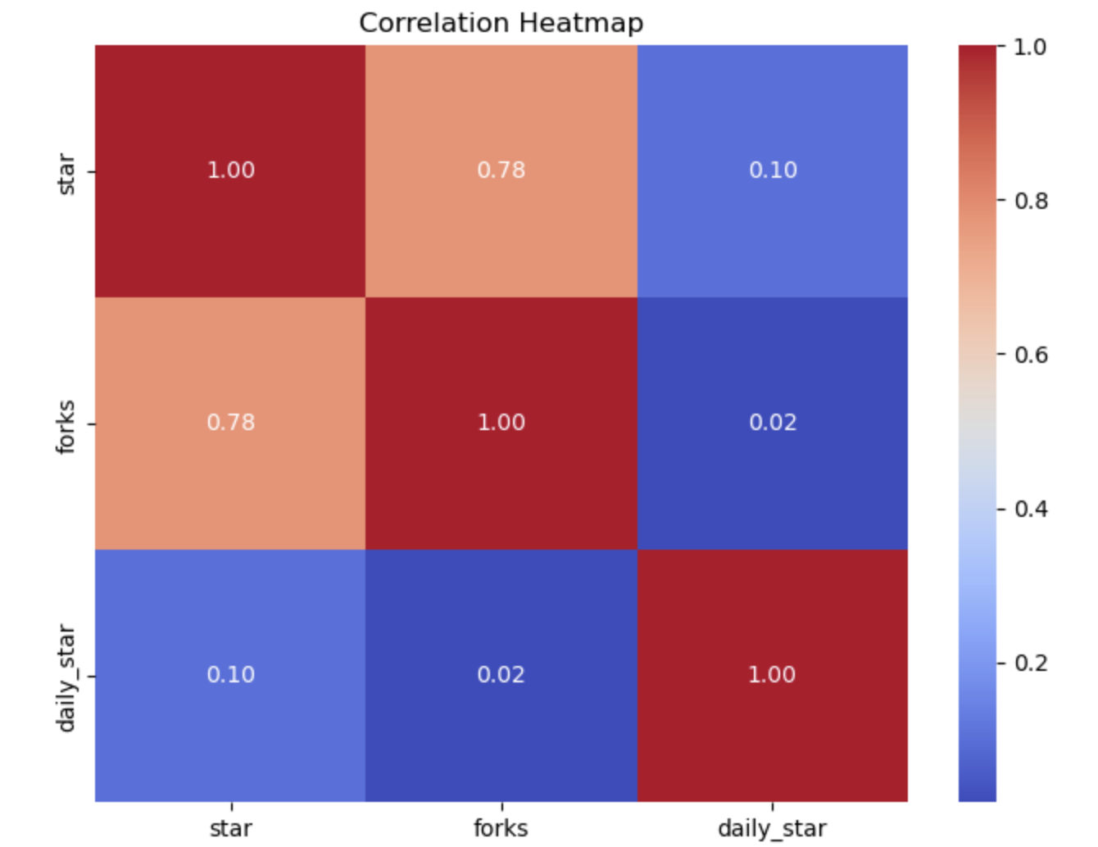
Correlation Heatmap:
The heatmap shows the correlation between three variables: star, forks, and daily_star.
The correlation between stars and forks is very high at 0.78, indicating a strong positive relationship.
The correlation between daily_star and forks or stars is very low, indicating minimal association.
This suggests that the number of stars and forks are strongly related, but the daily star count is independent of both.

Slide 17
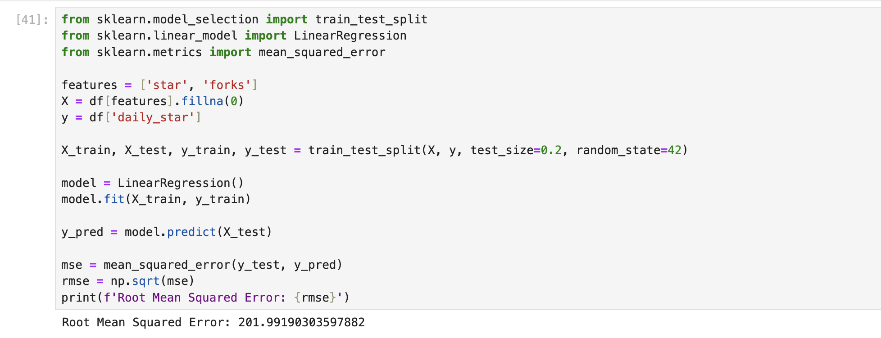
Linear Regression

Slide 18
It is a statistical method that uses a straight line to describe the relationship between a dependent variable and one or more independent variables. The line is defined by its slope and y-intercept.
Slope: The slope represents the change in the dependent variable for every unit change in the independent variable.
Y-intercept: The y-intercept represents the value of the dependent variable when the independent variable is equal to zero.
Code Output The code outputs the following results:
Root Mean Squared Error (RMSE): This value represents the average error between the actual values of the dependent variable and the values predicted by the linear regression model.
Interpretation
The RMSE of 201.99190303597882 suggests that, on average, the predictions made by the linear regression model are off by about 201.99. This indicates that the model may not be very accurate in predicting the dependent variable.
Linear Regression

Slide 19
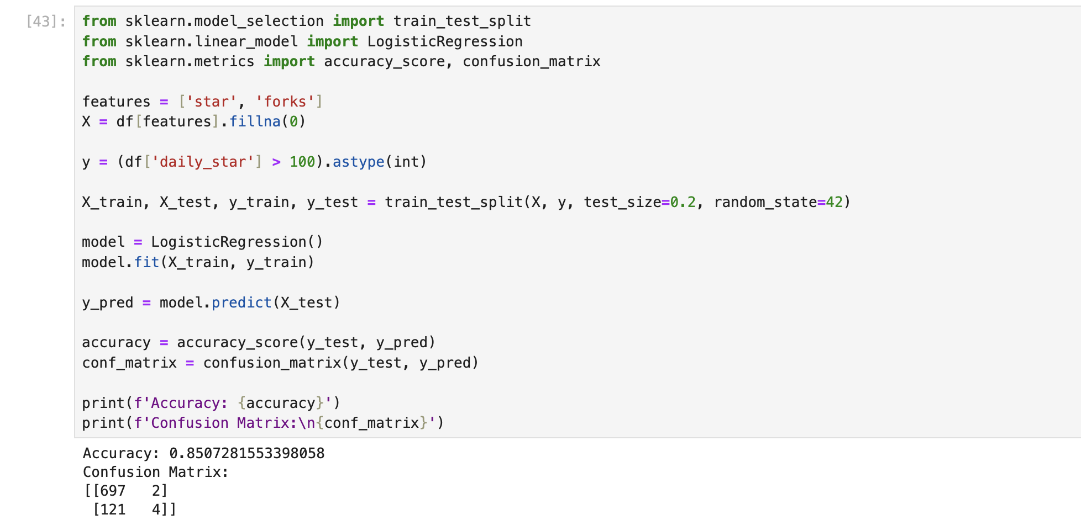
Logestic Regression

Slide 20
Logistic Regression
Logistic regression is a statistical method used for predicting the probability of a categorical dependent variable. The dependent variable can have two or more categories.
It's a linear model, meaning it uses a linear combination of features to predict the outcome.
The output of a logistic regression model is a probability score ranging from 0 to 1, representing the likelihood of the dependent variable belonging to a specific category.
This probability score is then used to classify the data into one of the categories based on a predetermined threshold.
Output:
Accuracy: This represents the percentage of correctly predicted outcomes. In this case, the model achieved an accuracy of 85%.
Confusion Matrix: This is a table that shows the number of correct and incorrect predictions for each category.
The matrix indicates that 697 instances were correctly classified as belonging to one category, while 2 were incorrectly classified as belonging to the other.
Similarly, 121 instances were incorrectly classified as belonging to the first category, and 4 were correctly classified as belonging to the other.

Slide 21
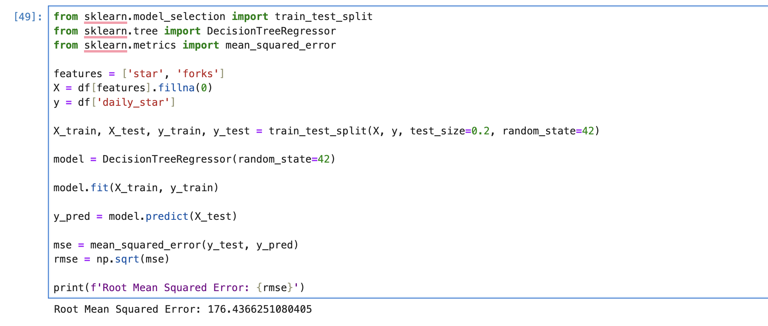
Decision Tree

Slide 22
Decision Tree
A decision tree is a supervised learning algorithm used for both classification and regression tasks. It is a tree-like structure where each internal node represents a feature, each branch represents a possible value of that feature, and each leaf node represents a prediction or classification.
Tree Construction: The tree is built iteratively, starting from the root node. At each node, the algorithm selects the best feature to split the data based on a specific metric, such as information gain or Gini impurity.
Splitting: The data is divided into subsets based on the chosen feature's values.
Leaf Nodes: The process continues recursively until a stopping condition is met, such as reaching a predefined depth or a minimum number of samples in a node. Leaf nodes represent the final prediction or classification for that branch.
Output:
The output of the code is the Root Mean Squared Error (RMSE) of the model.
The RMSE is 176.4366251080405.

Slide 23
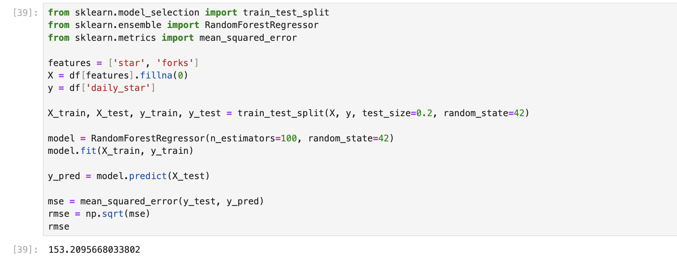
Random Forest

Slide 24
Random Forest
A supervised learning algorithm that uses multiple decision trees to make predictions.
Each decision tree is built on a random subset of the data and features.
Predictions are made by averaging the predictions of all the trees in the forest.
This ensemble approach helps to reduce overfitting and improve the accuracy of the model.
Output:
The output 153.2095668033802 represents the root mean squared error (RMSE) of the Random Forest model on the test data.
RMSE is a measure of the difference between the predicted values and the actual values.
A lower RMSE indicates a better model performance.

Slide 25
Results and Discussion
The results highlighted several key findings:
Certain programming languages, such as JavaScript and Python, consistently appeared in trending repositories.
A positive correlation was found between the number of stars and forks, indicating that popular repositories tend to be forked more frequently.
Trends showed seasonal variations, with spikes in certain technologies during specific periods.

Slide 26
Conclusion
The analysis of trending GitHub repositories provides valuable insights into the evolving landscape of software development. By understanding the factors that contribute to a repository's popularity, developers and organizations can make informed decisions about technology adoption and community engagement. Future work could involve deeper analysis of specific technologies or the impact of external events on repository trends.

